Slide 1
Accessible Exercise: Improving Parks and Recreation in the City of Pontiac
Corey Rowe
Presenter
Dr. Jennifer Lucarelli
Project Mentor, Interdisciplinary Health Sciences

Slide 2
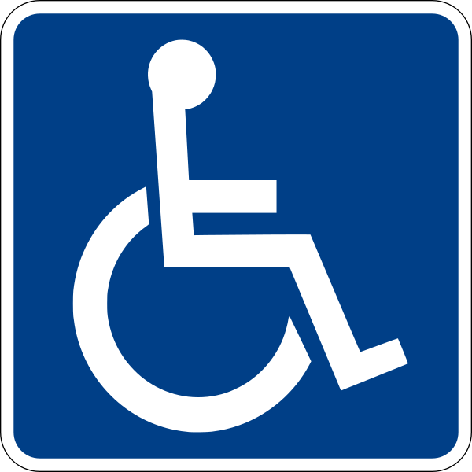
Introduction
Community-engaged public health research
Encourage physical activity among the disabled
Goal: Identify specific barriers to accessibility through visual and location-based evidence

Slide 3
Gathering Existing Data
(Michigan Department of Natural Resources, 2016)
(Oakland County, 2017)
(Reinvestment Fund, 2017)

Slide 4
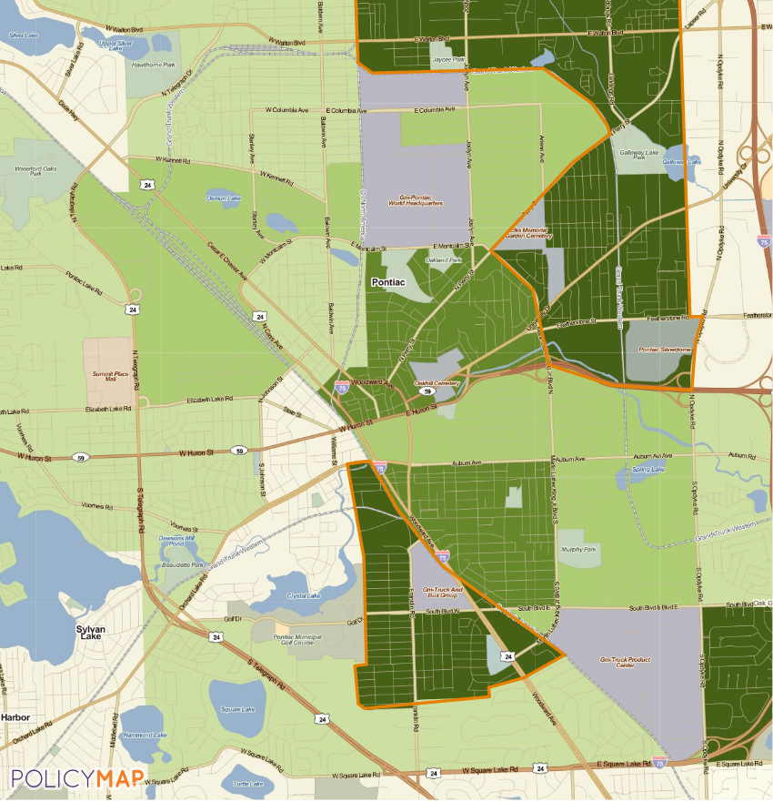
Data: PolicyMap
Provides demographics from 2010 U.S. Census
Used heavily by Oakland County’s Economic Development & Community Affairs Department
Filter through population data

Slide 5
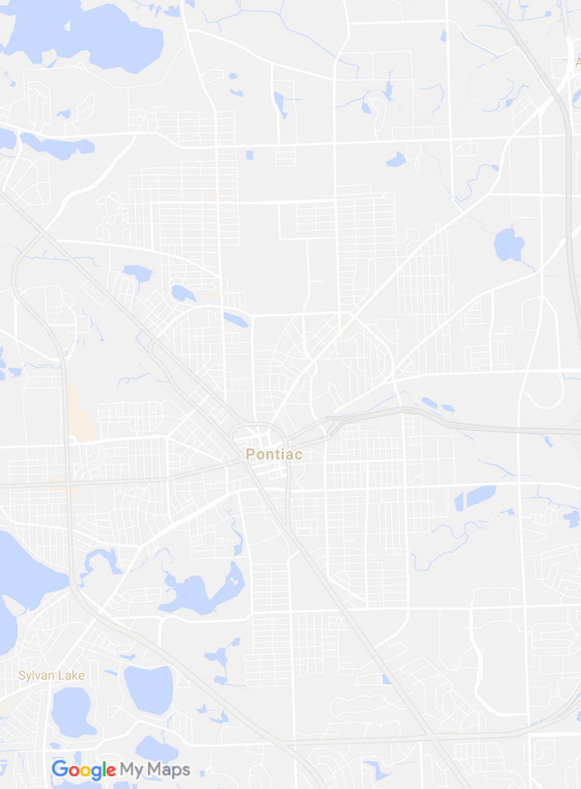
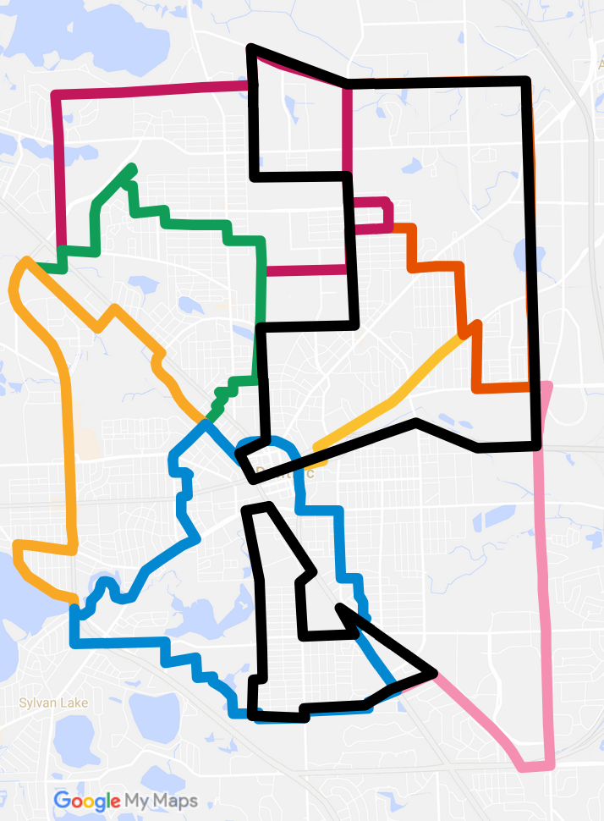
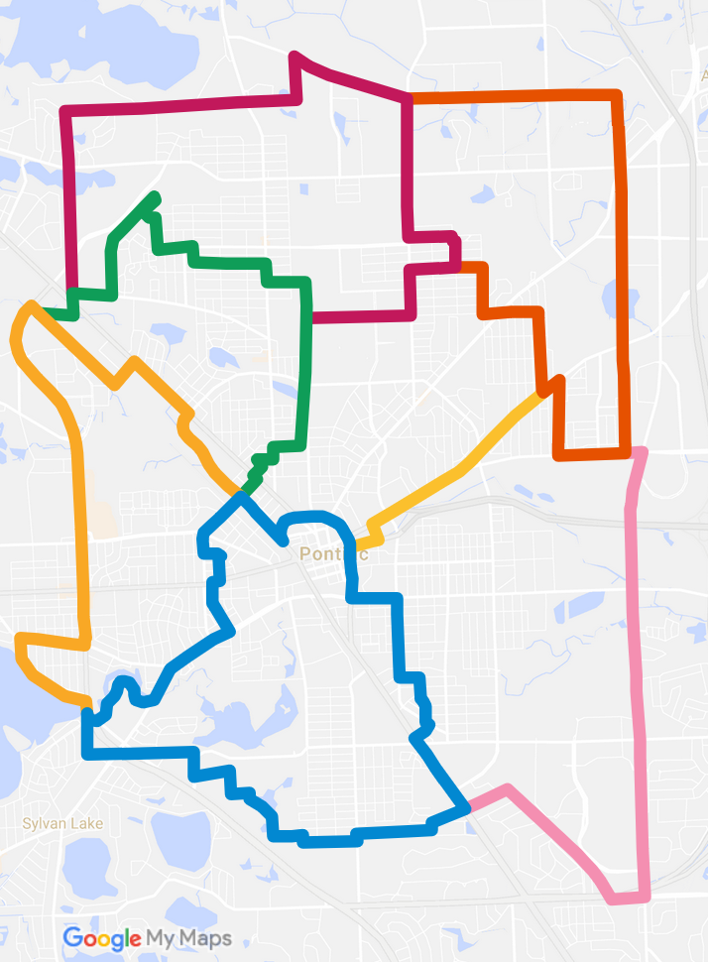
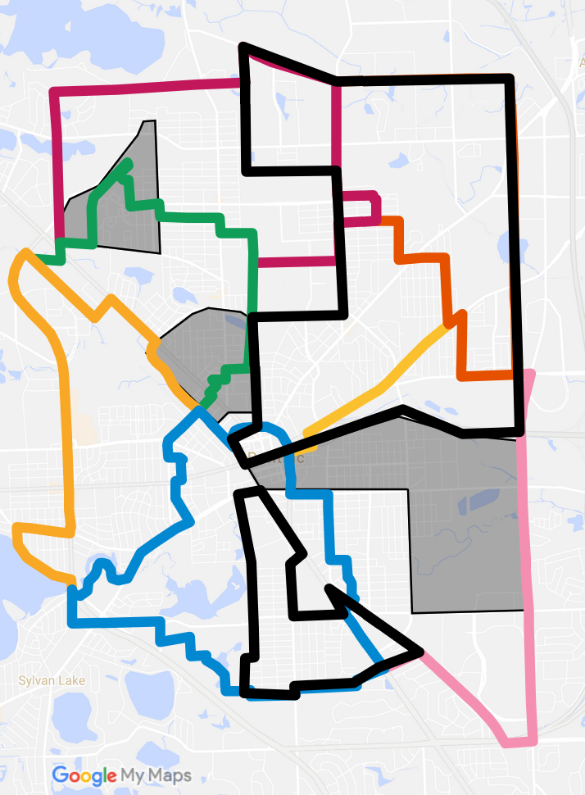
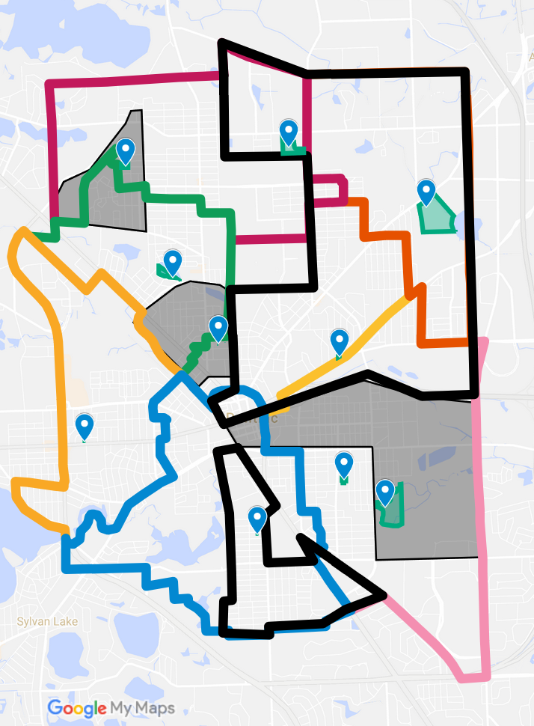
Data: The Plan
Prepare a composite map
Select parks methodically
Represent all seven council districts

Slide 6
Collecting Data, Part 1: Taking Inventory
Before visiting a park:
Record park information, including:
Name
Date
Location
Park Type
During a park visit:
Record presence of park facilities and accessibility features, including:
Wheelchair transfer stations and access ramps
Quality of ground surfaces
Condition of park seating and entranceways

Slide 7
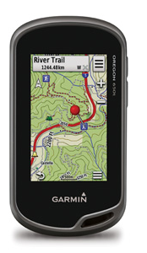
Collecting Data, Part 2: Waypoints and Pictures
During a park visit, several pictures were taken at each facility recorded on the inventory sheet.
Whenever a picture was taken, a waypoint was marked at the location.
After visiting a park, waypoints, tracks, and images were exported to a computer.

Slide 8
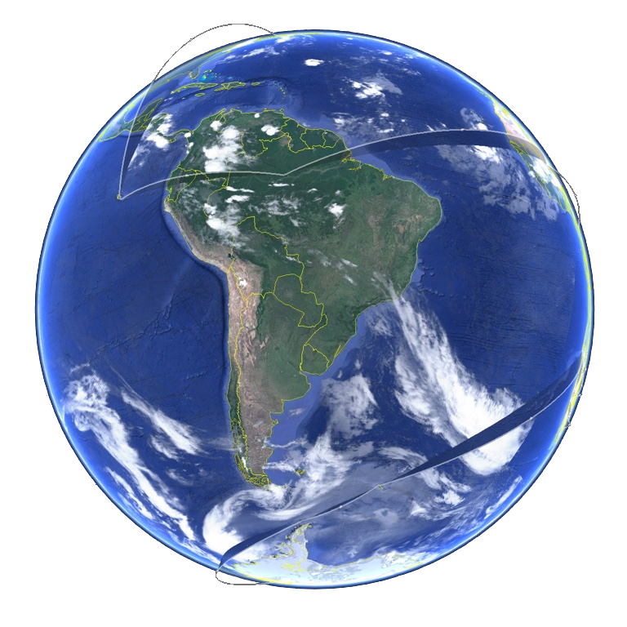
Collecting Data, Part 3: Organization
Google Earth Pro
“Visualize, manipulate and export GIS data” (Google, 2017)
Data cleaning
Why use a geographic information system (GIS)?
Standard format
Easy to share collected data

Slide 9
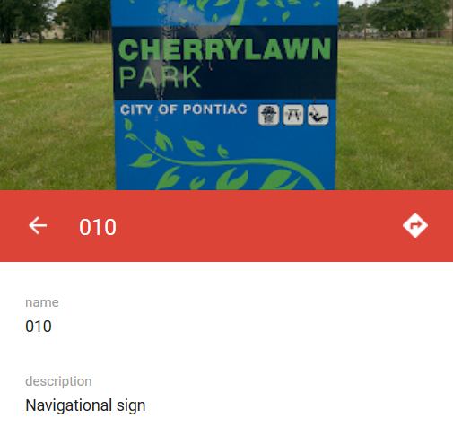
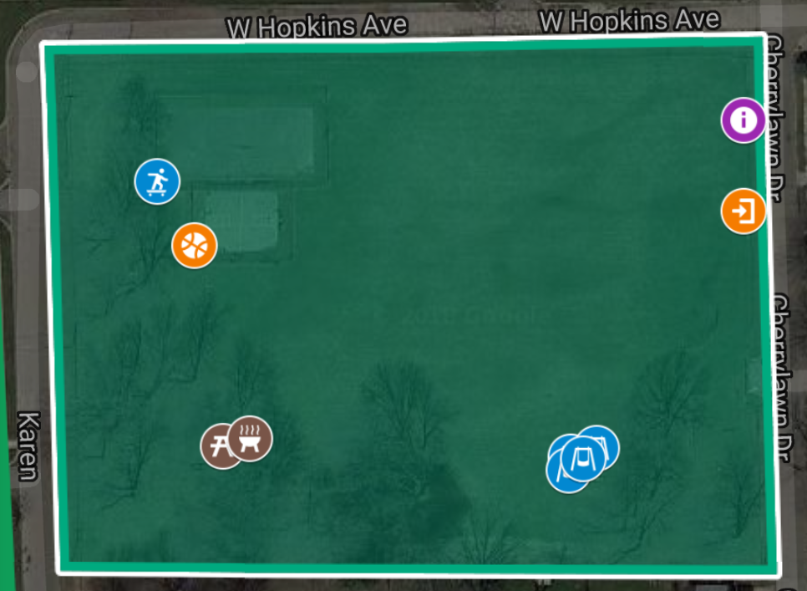
Results: Building the Map
Figure 1. A portion of the data as seen in Google My Maps. Data is organized by waypoint number.

Slide 10
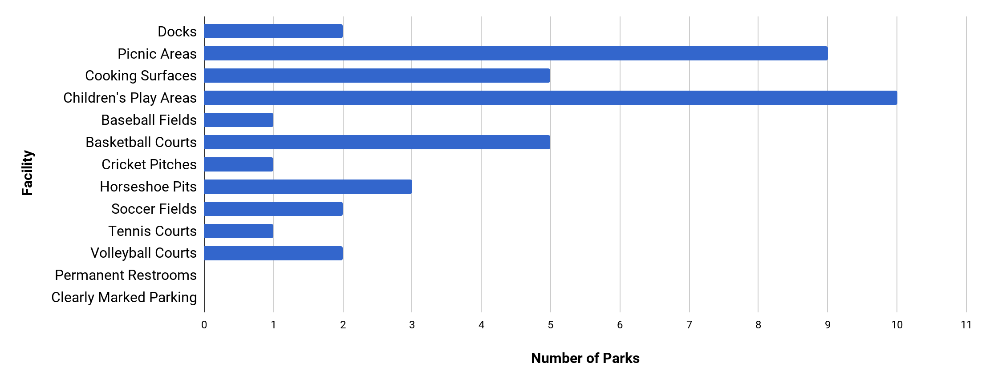
Results: Park Facilities
Figure 2. A summary of facilities in the city parks surveyed.

Slide 11
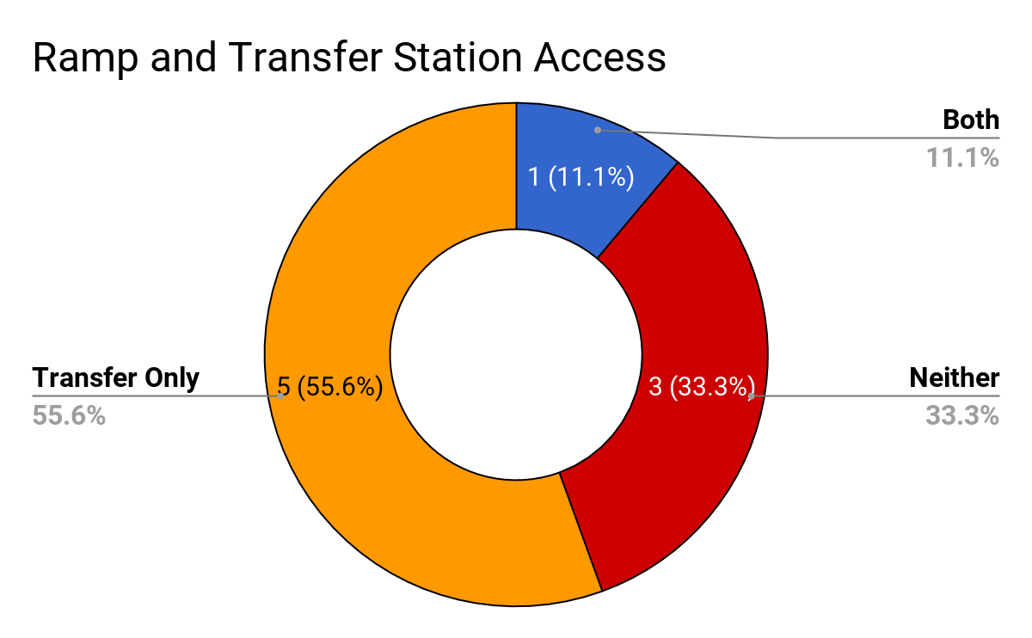
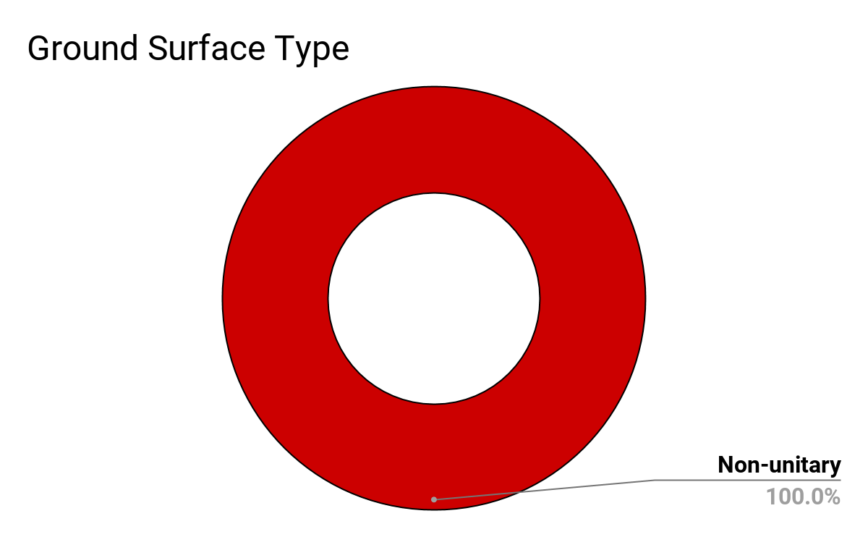
Results: Accessibility
Figures 3 and 4. A summary of the accessibility of children’s play areas.

Slide 12
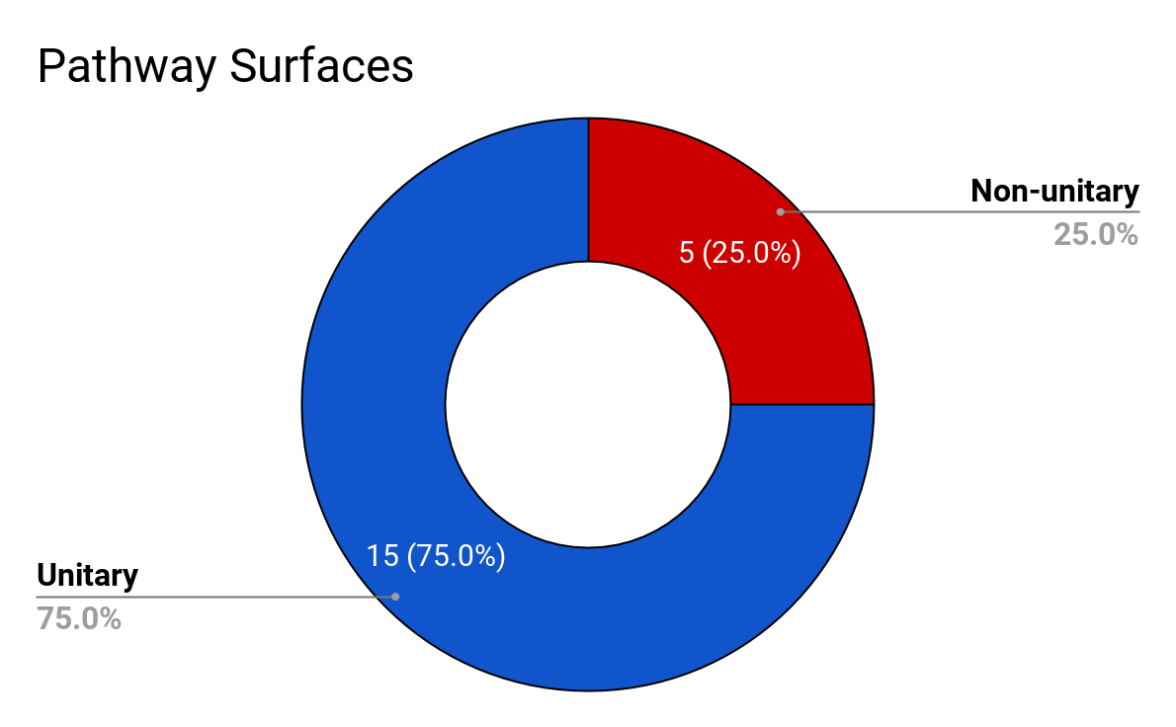
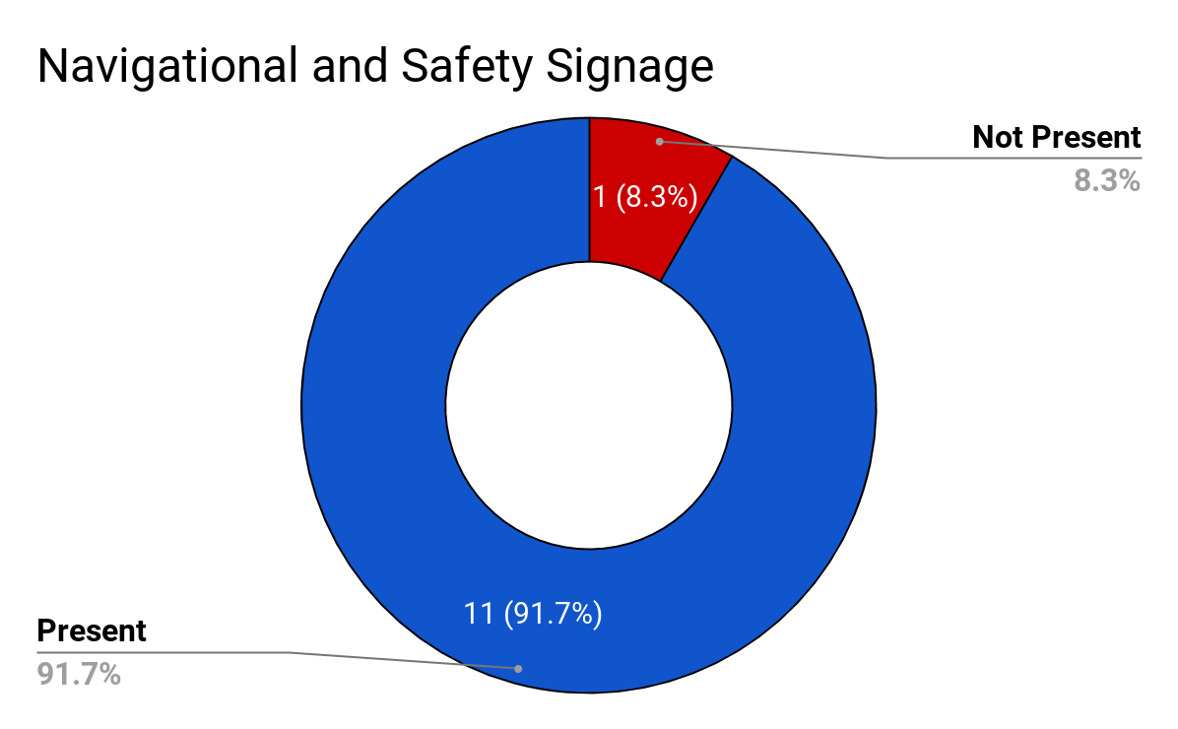
Results: Accessibility (continued)
Figures 5 and 6. A summary of the accessibility of pathways and signage.

Slide 13
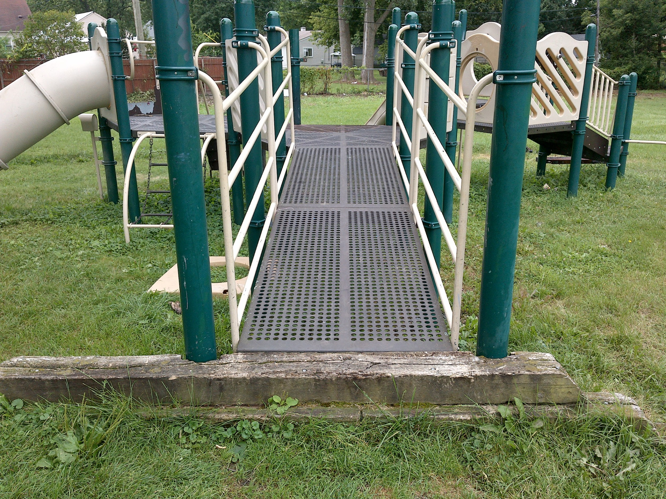
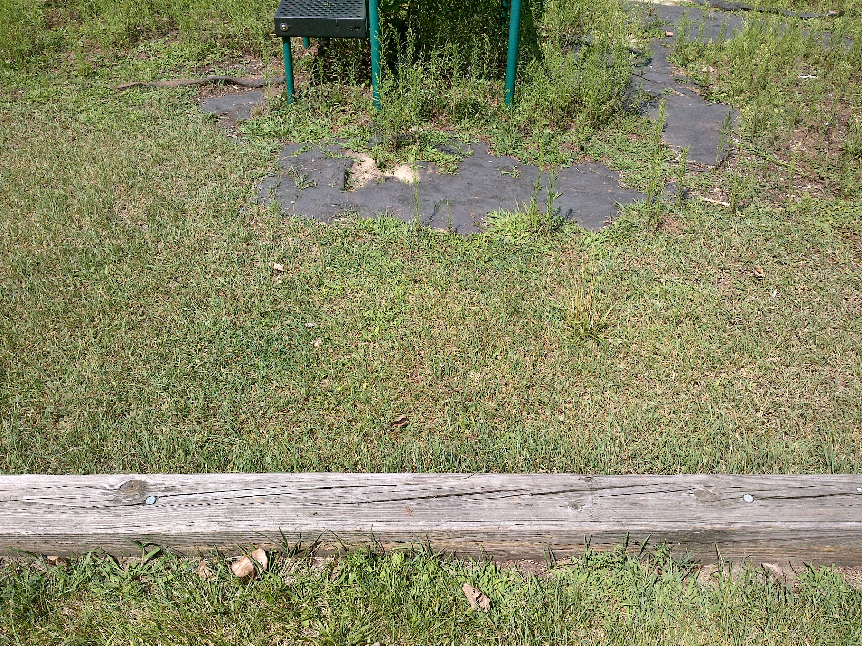
Results: Children’s Play Areas
Figures 7 and 8. Entrances to the Cherrylawn Park play area. [GPX: 003, 016]

Slide 14
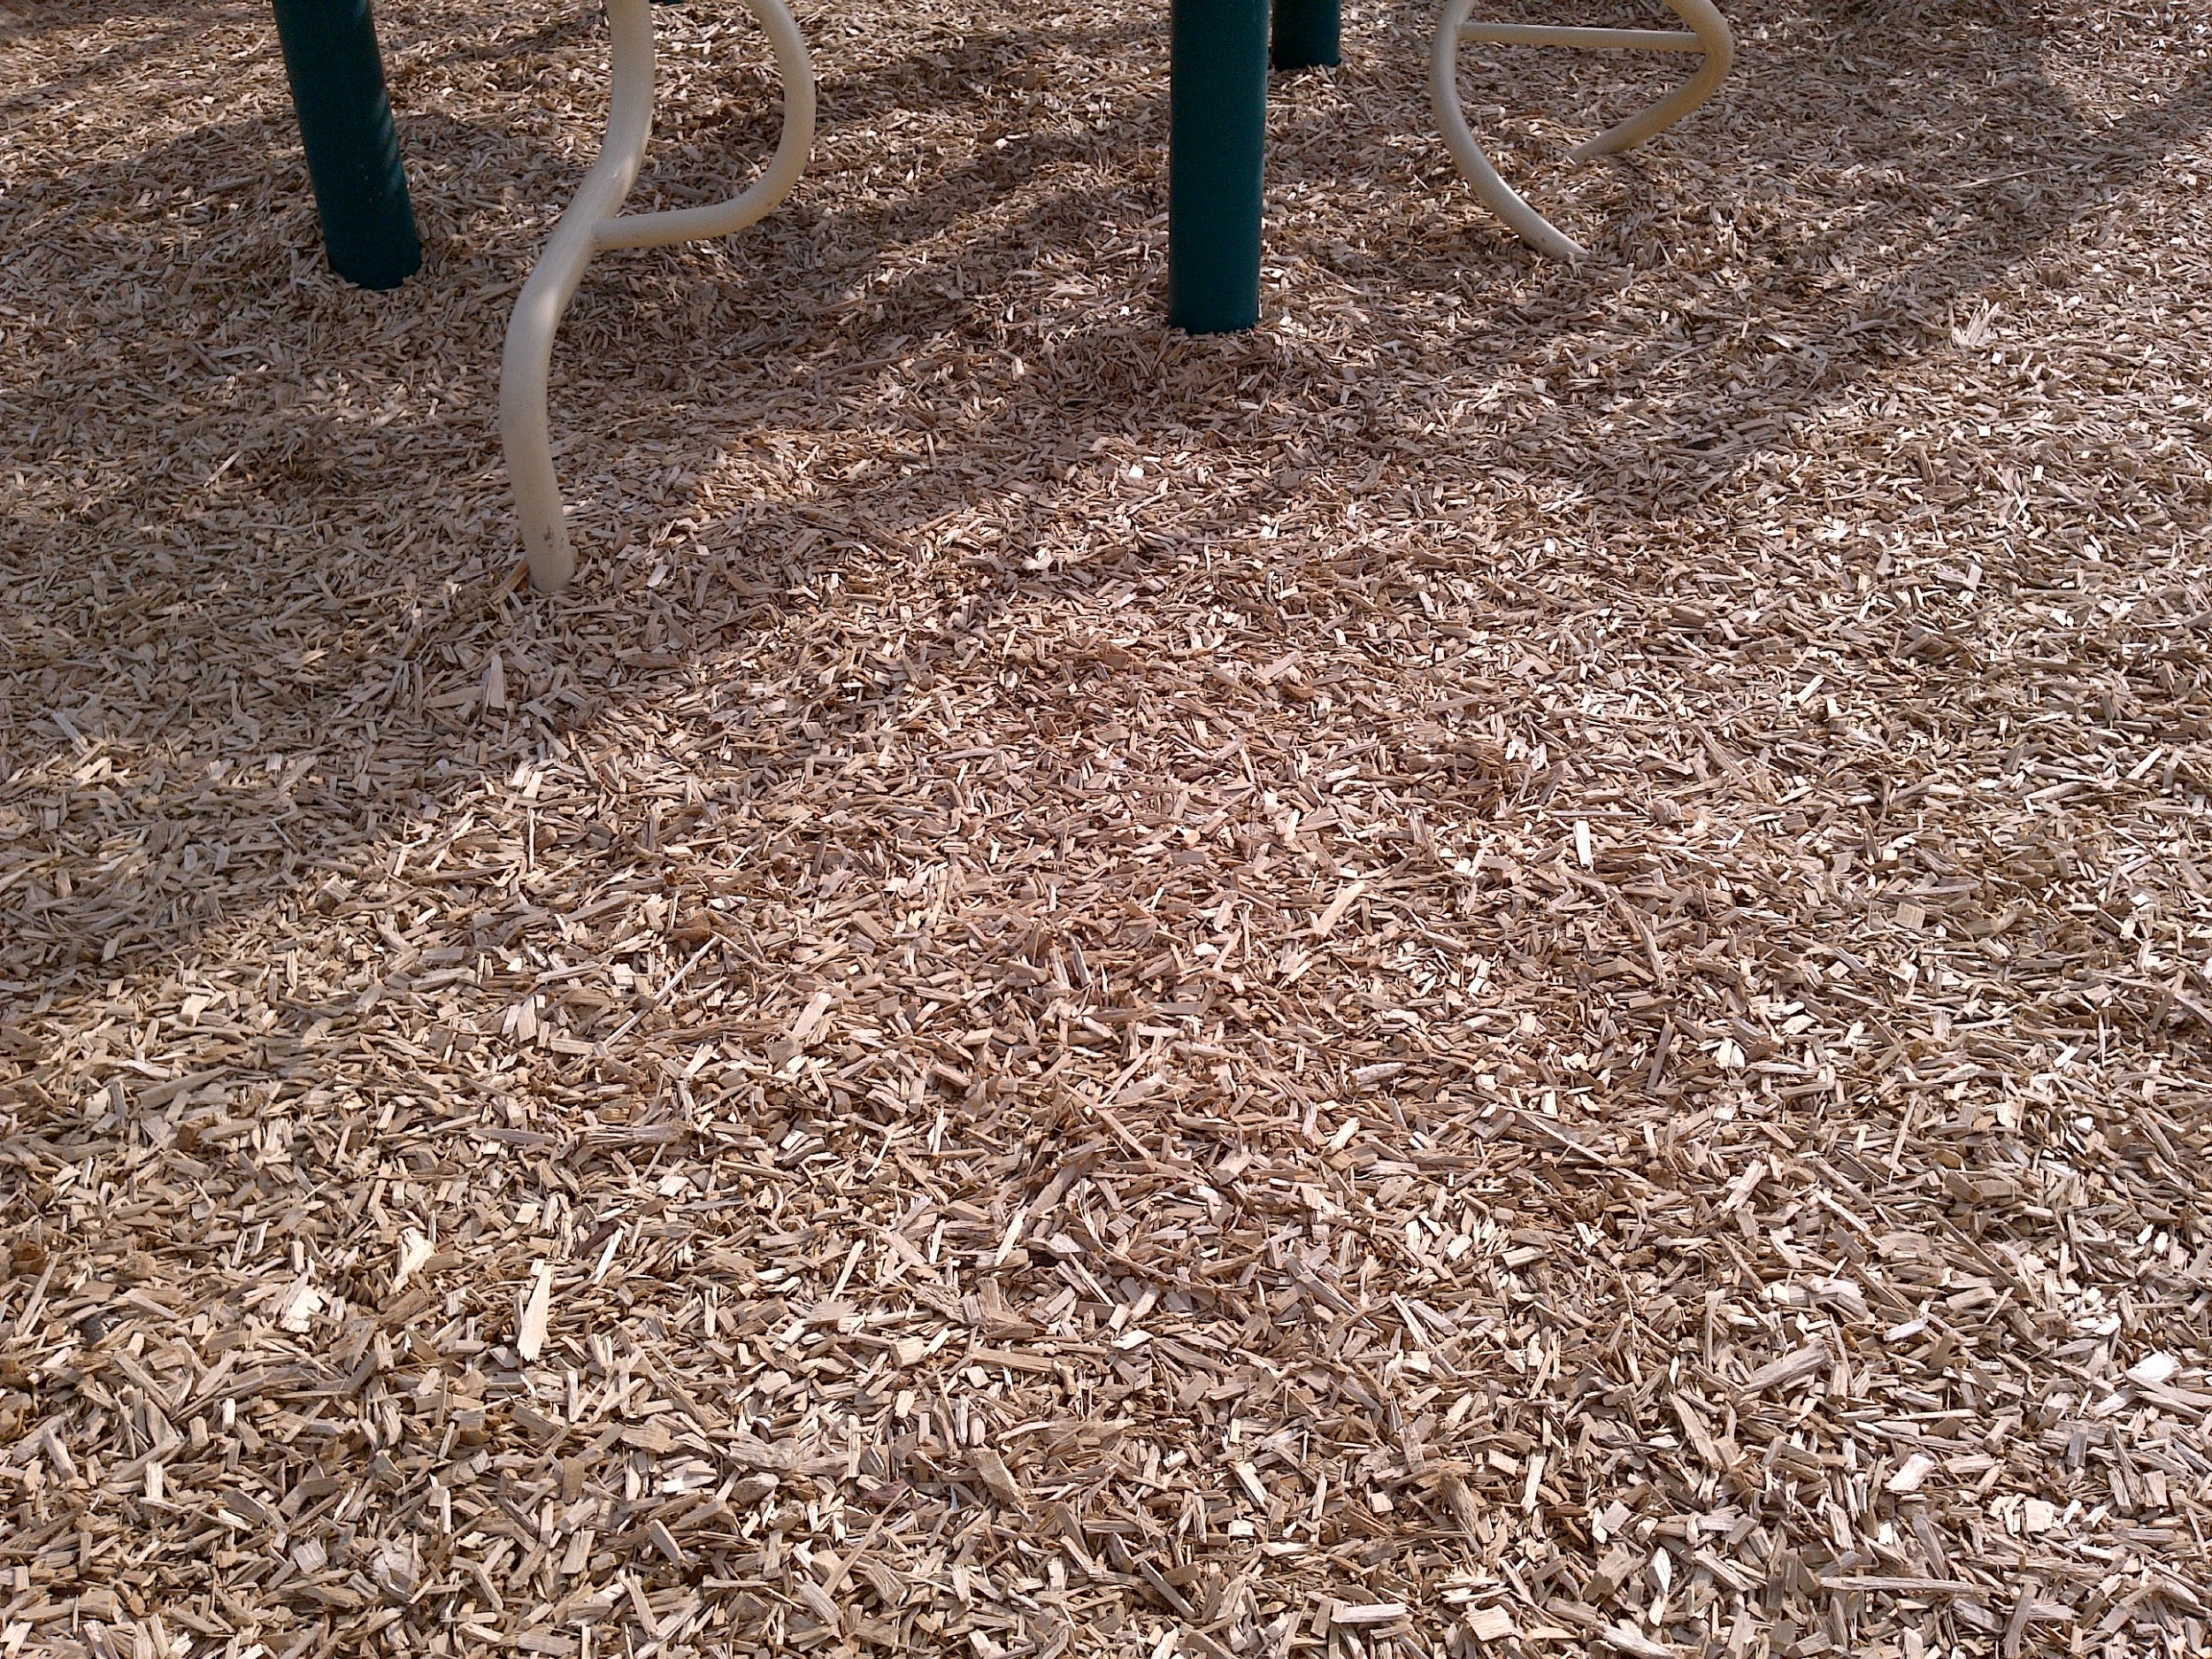
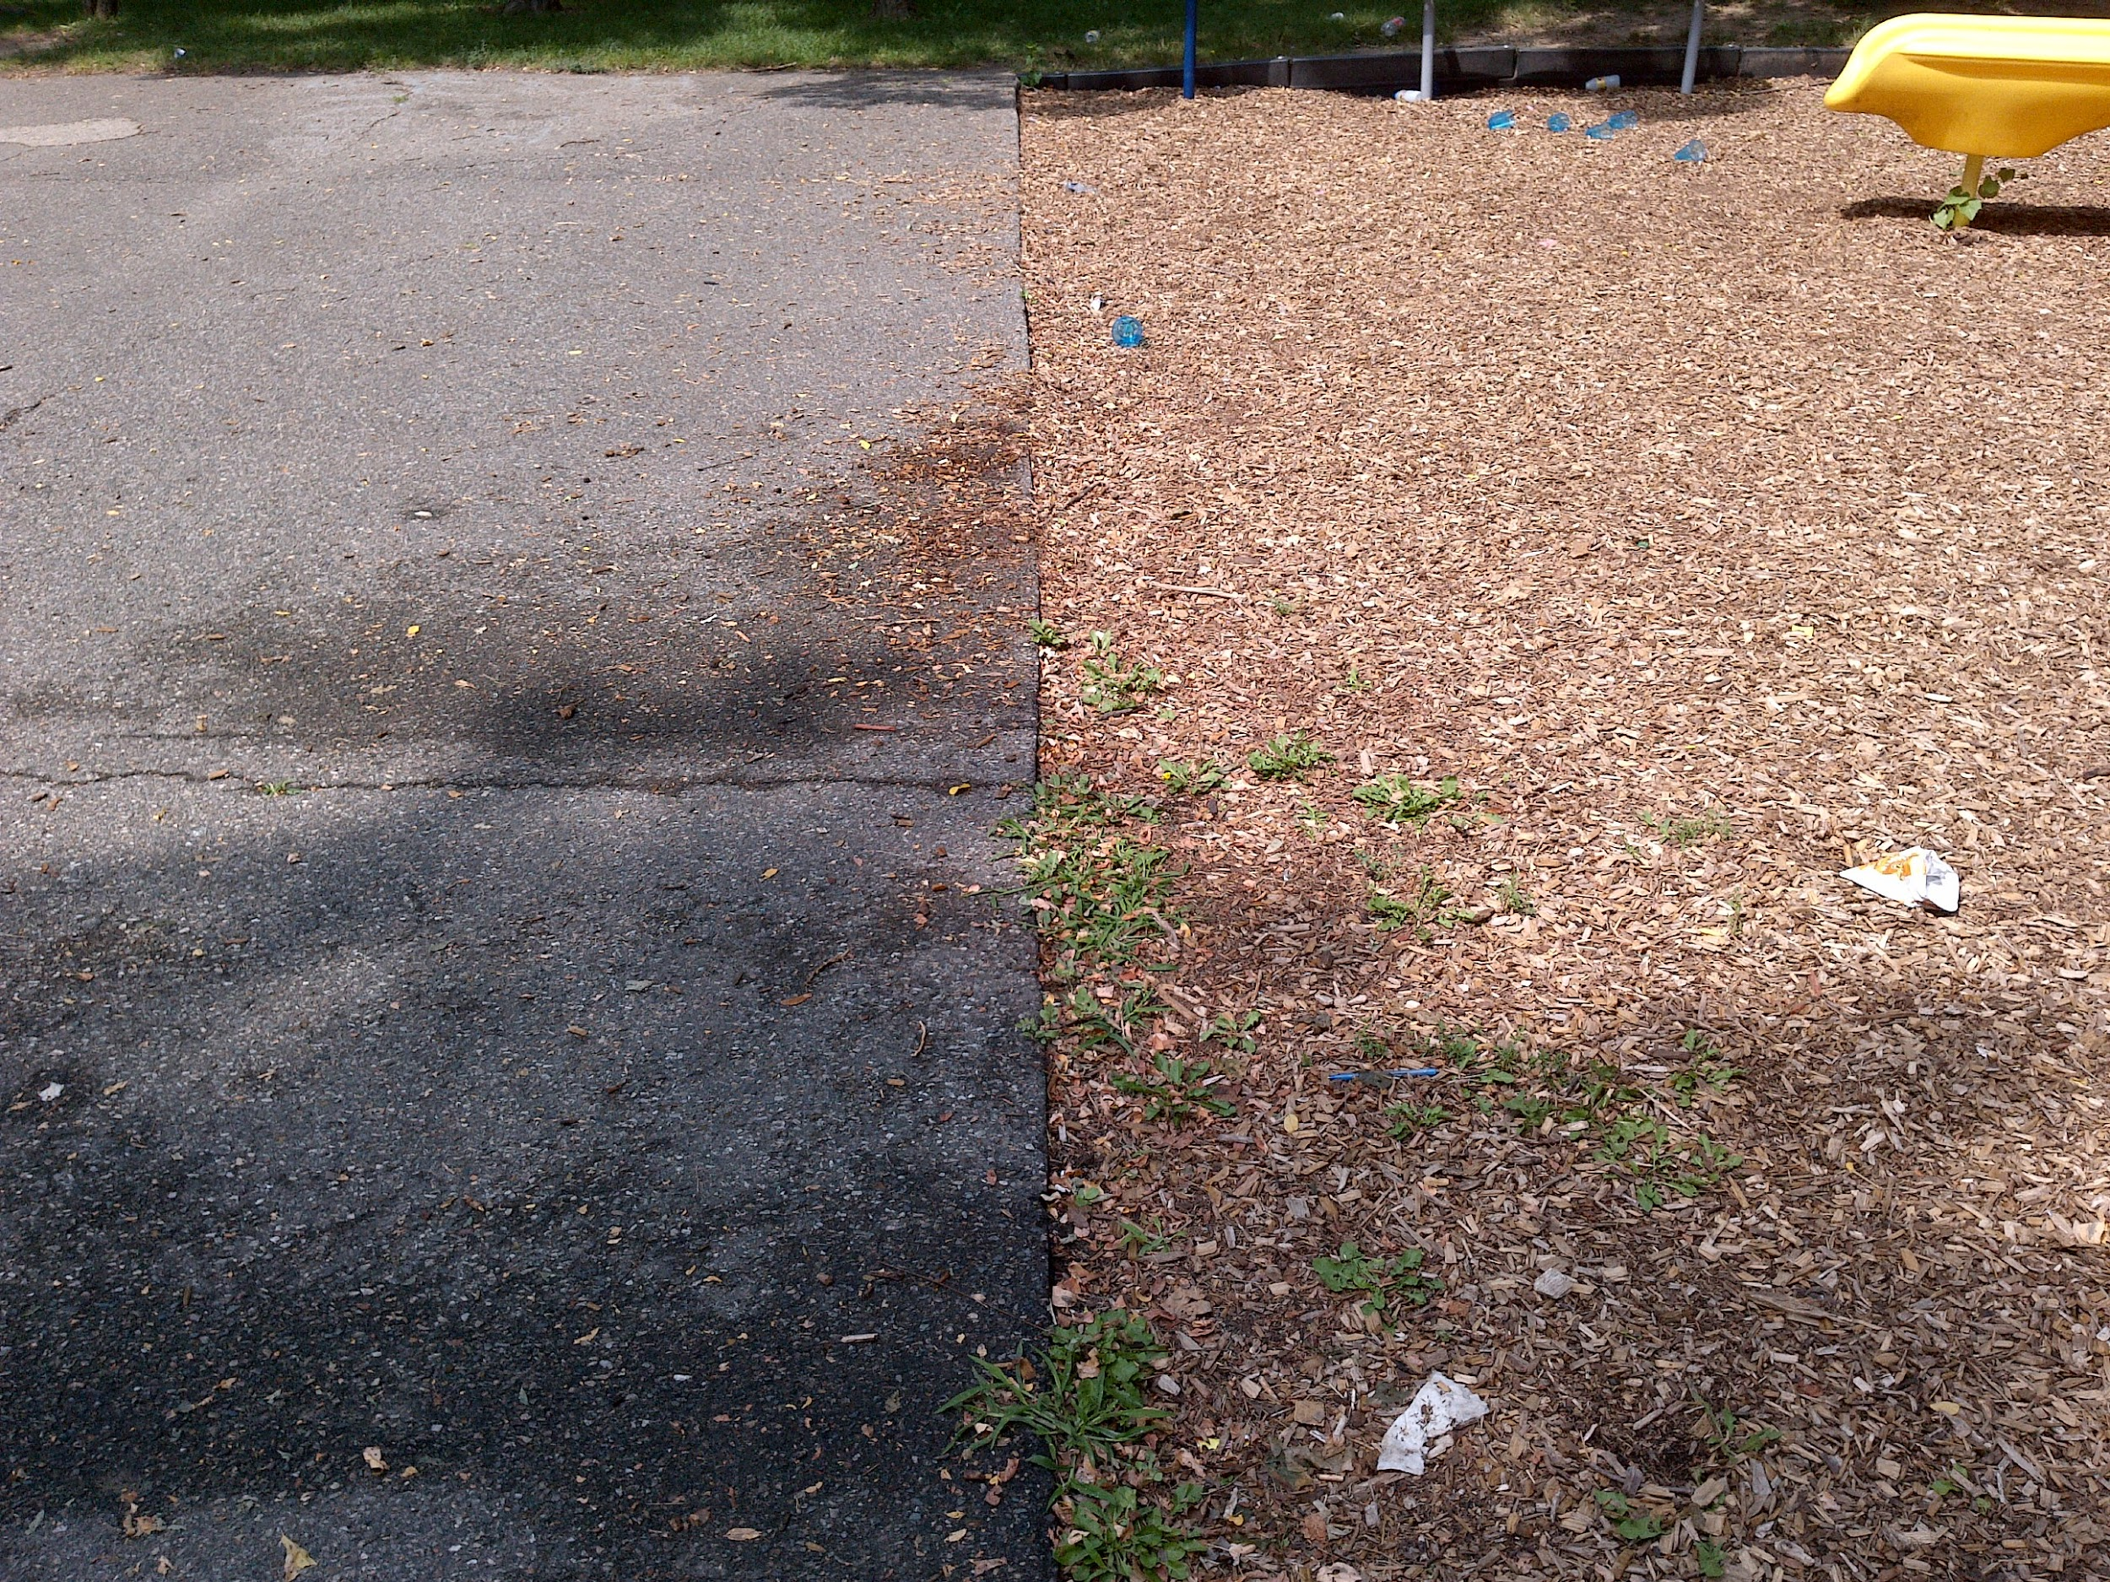
Results: Ground Surfaces
Figures 9 and 10. Most play areas in the city rest on non-unitary surfaces, such as grass or wood chips. [GPX: 033, 059]

Slide 15
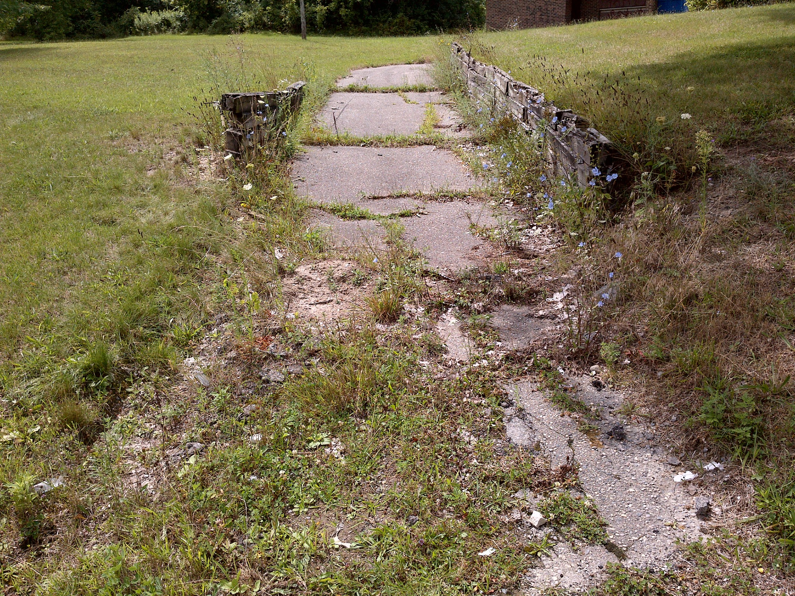
Results: Pathways
Figure 11. Pathways to park facilities have become unusable. [GPX: 088]

Slide 16
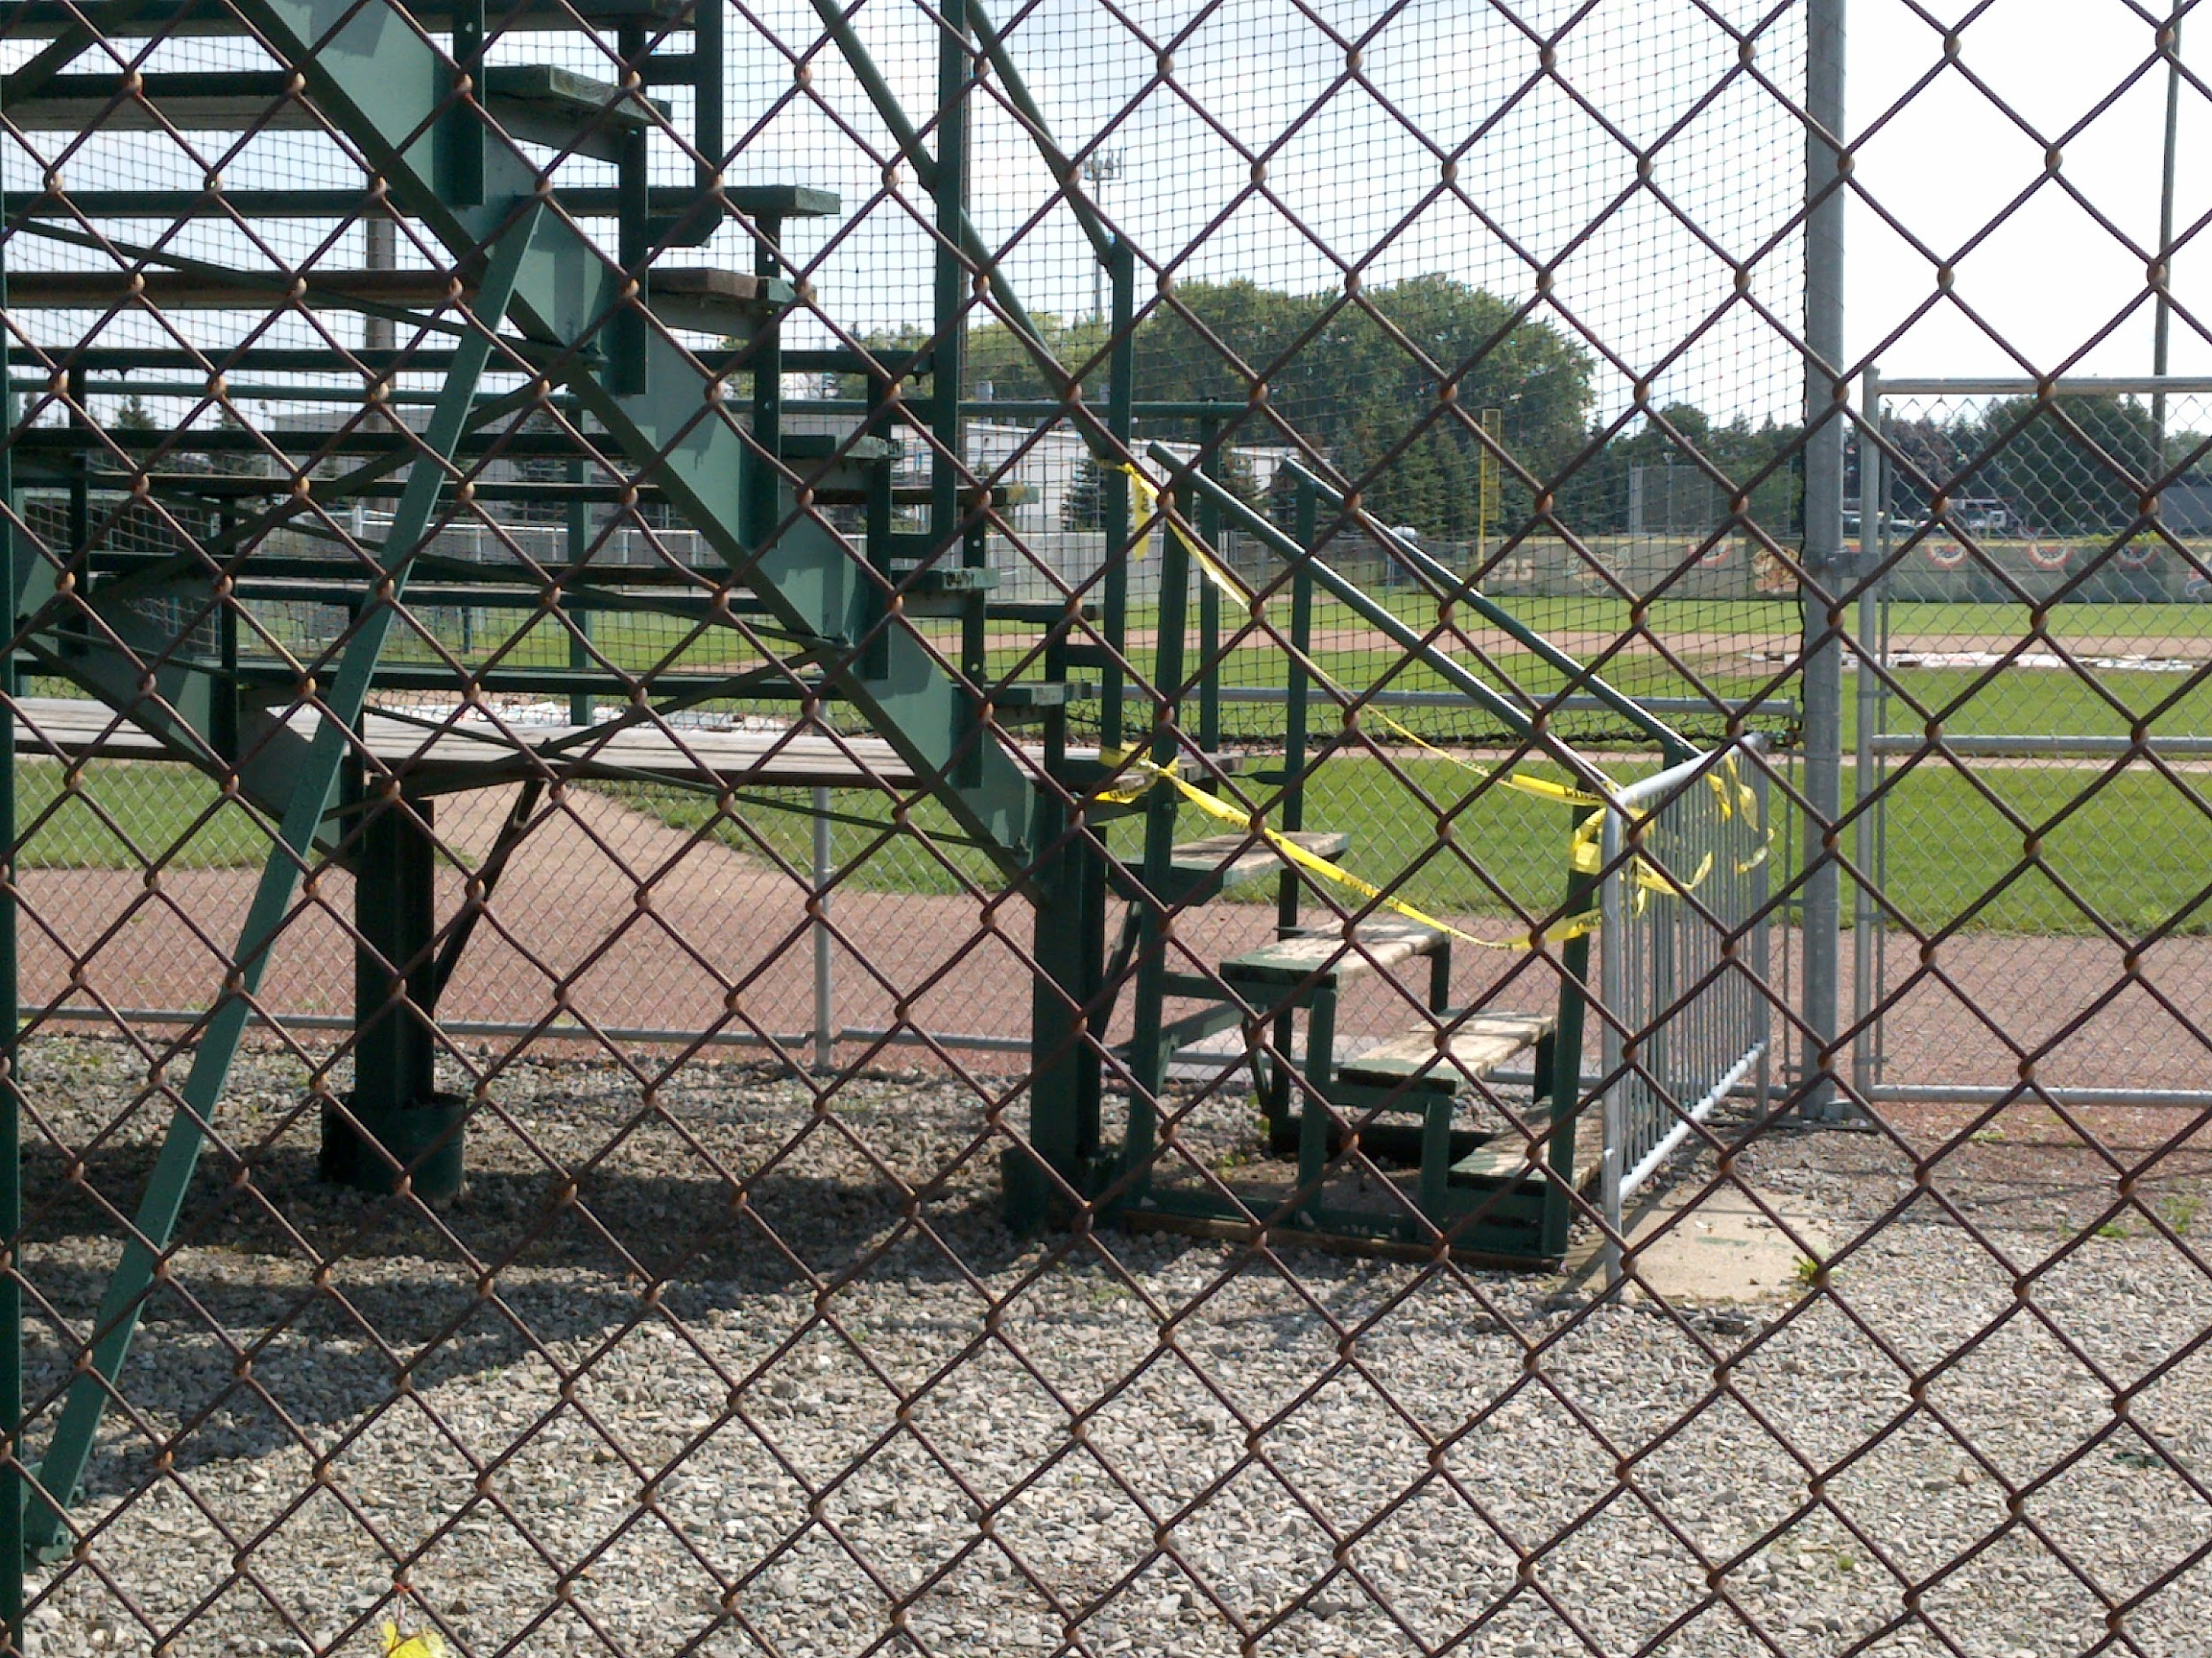
Results: Wheelchair Access
Figure 12. Accessing park facilities by wheelchair is not possible in many cases. These baseball stands, for example, are accessible only by stairs. [GPX: 114]

Slide 17
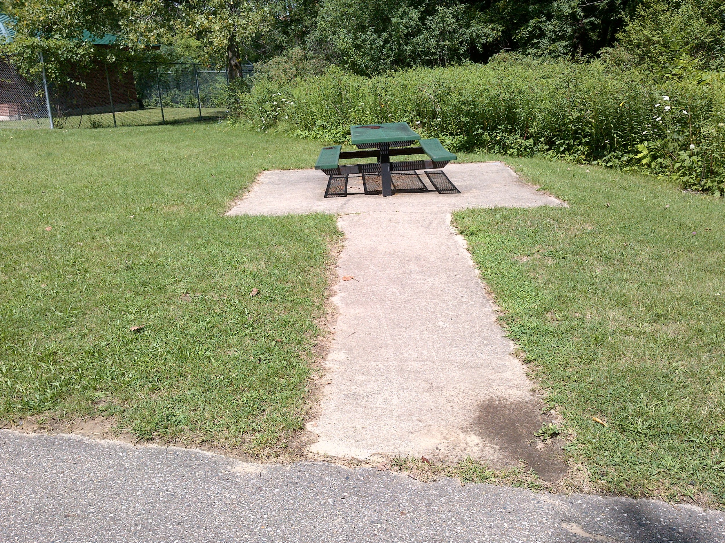
Results: Picnic Areas
Figure 13. A great example of an accessible picnic table. Although it does not have wheelchair seating, the surface surrounding and leading to the table is clear, level, and unitary. [GPX: 077]

Slide 18
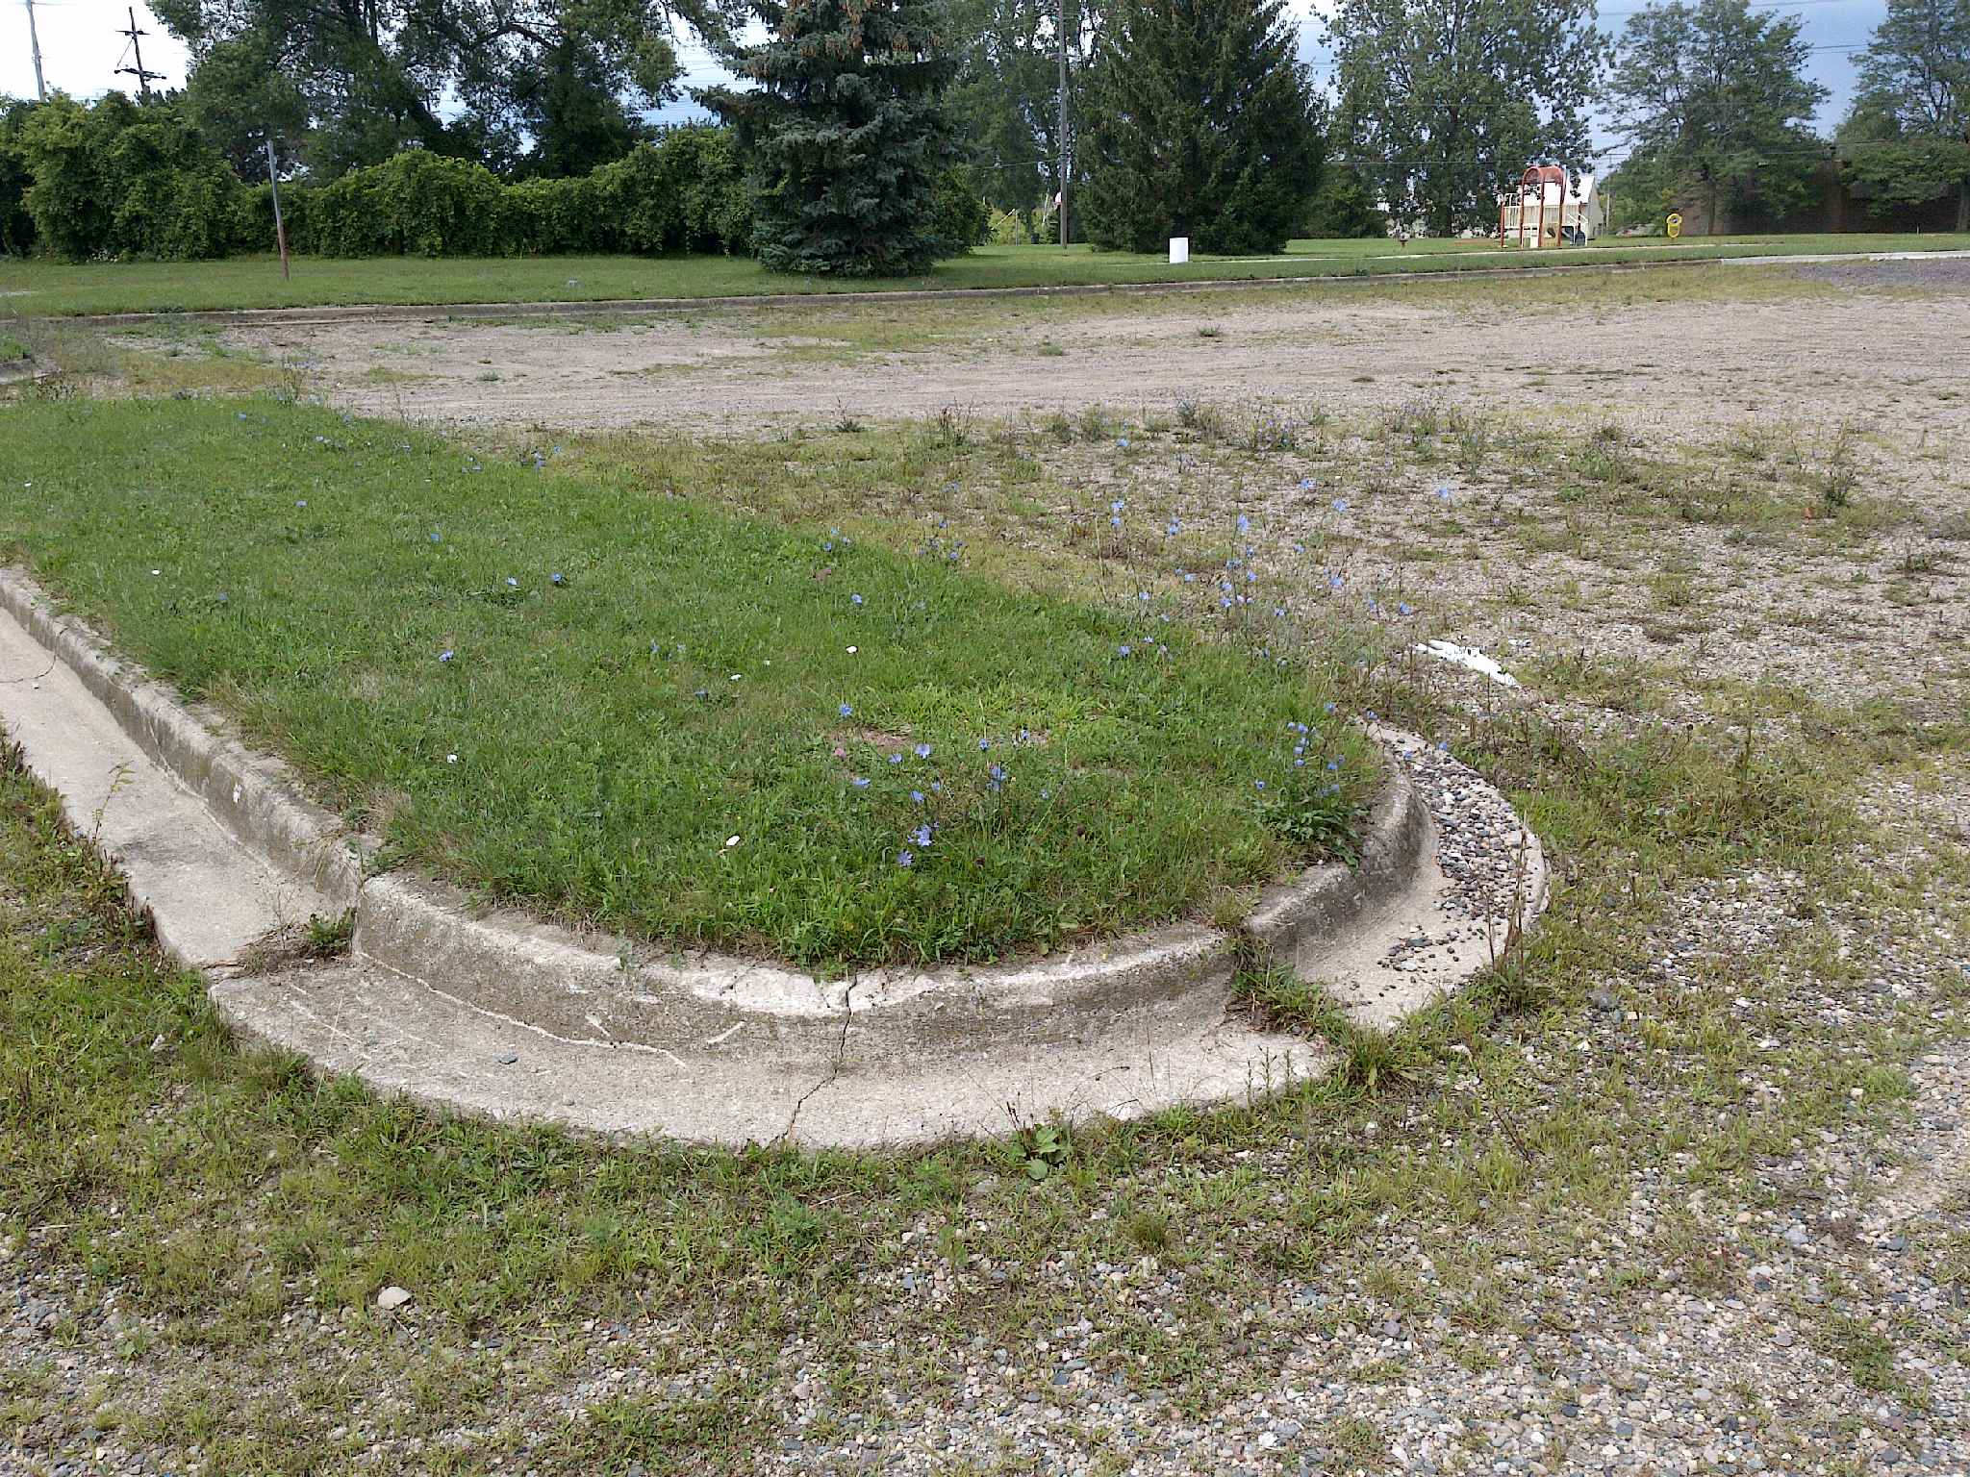
Results: Parking
Figure 14. A lack of designated parking spaces and paved lots may prevent disabled individuals from reaching park facilities entirely. [GPX: 089]

Slide 19
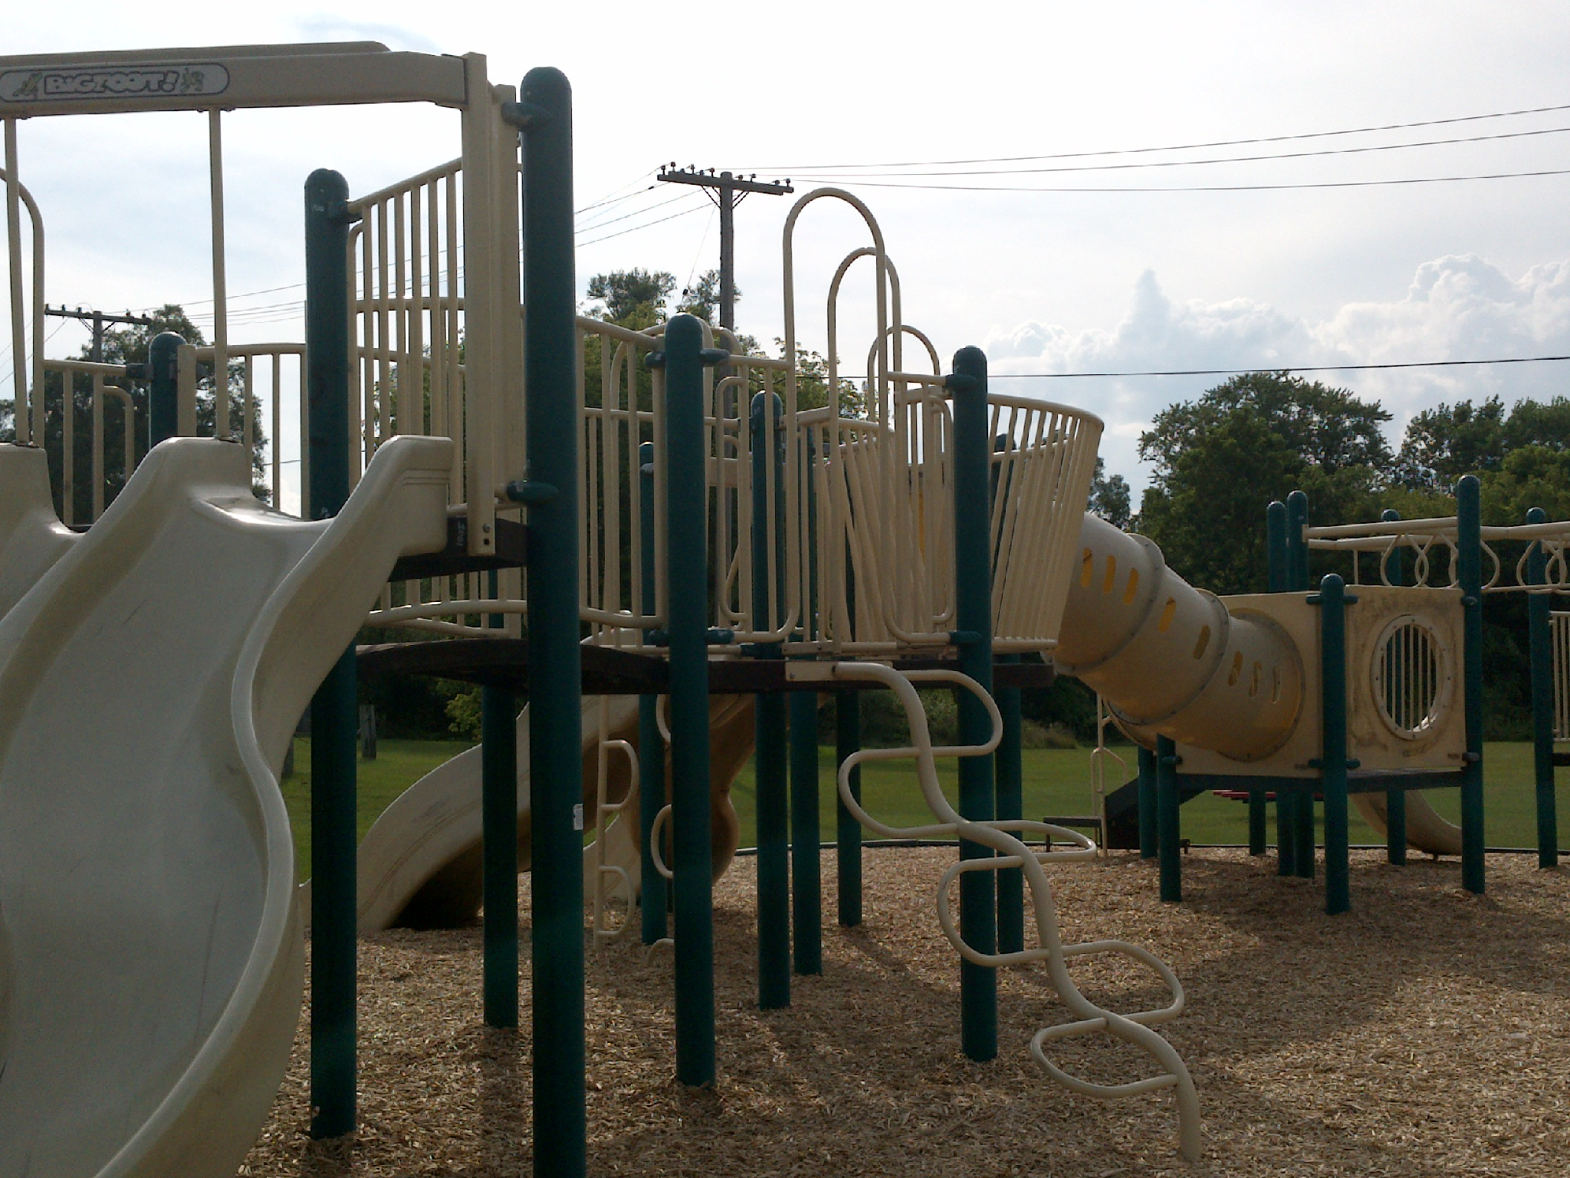
Discussion: Findings
Children’s Play Areas
Most effective potential improvement
Pathways and Facility Access
Short-term: Repair or weed existing pathways
Long-term: Connect unreachable facilities

Slide 20
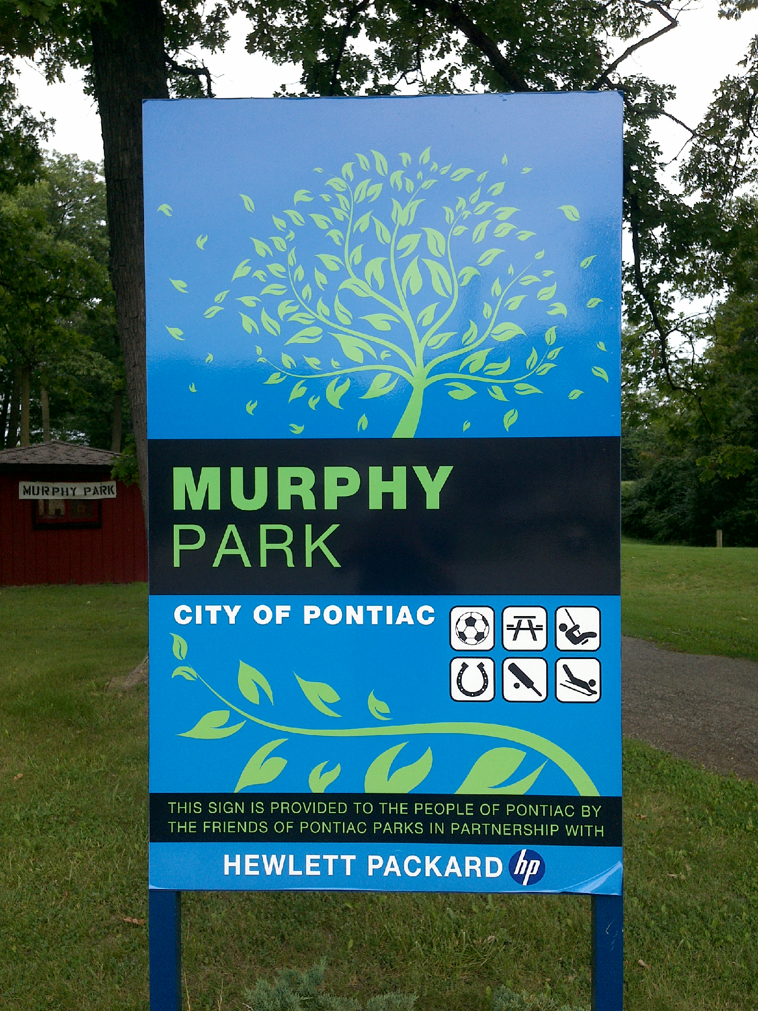
Discussion: Findings (continued)
Parking
Propose designated accessible parking spaces
Navigation
Maintain navigational signage

Slide 21
Conclusion and Future Plans
Barriers Identified
Many issues can be corrected without major efforts
Some long-term solutions will require further investigation to determine cost and feasibility
Using the Results
Updating the Parks and Recreation Master Plan
Encouraging involvement of those with disabilities
Improving the Project
Longer data collection window, additional researchers
Potential replication
Quality of existing data

Slide 22
Thank you!
Project Data and Complete Report
https://accessibleparksproject.org
Dr. Jennifer Lucarelli
Project Mentor, Interdisciplinary Health Sciences
lucarell@oakland.edu
Kristen Wiltfang
Economic Development & Community Affairs, Oakland County
wiltfang@oakgov.com
Questions?
Corey Rowe
Presenter
cjrowe@oakland.edu

Slide 23
References
Brown, G., Schebella, M., & Weber, D. (2014). Using participatory GIS to measure physical activity and urban park benefits. Landscape
and Urban Planning, 121, 34-44. doi:10.1016/j.landurbplan.2013.09.006
Carroll, D. D., Courtney-Long, E. A., Stevens, A. C., Sloan, M. L., Lullo, C., Visser, S. N., . . .
Dorn, J. M. (2014). Vital signs: Disability and physical activity--United States, 2009-2012. Morbidity and Mortality Weekly Report,
63(18), 407-13.
City of Pontiac. (2014). City council.
Garmin Ltd. (2017). Oregon® 650t.
Google Inc. (2017). Earth pro on desktop.
McCormack, G. R., Rock, M., Toohey, A. M., & Hignell, D. (2010). Characteristics of urban parks associated with park use and
physical activity: A review of qualitative research. Health & Place, 16(4), 712-726. doi:10.1016/j.healthplace.2010.03.003

Slide 24
References (continued)
Michigan Department of Natural Resources. (2016). Guidelines for the development of community park, recreation, open space, and
greenway plans. Web.
Oakland County. (2014). Oakland county, Michigan.
Oh, K., & Jeong, S. (2007). Assessing the spatial distribution of urban parks using GIS. Landscape and Urban Planning, 82(1), 25-32.
doi:10.1016/j.landurbplan.2007.01.014
Open Geospatial Consortium. (2017). KML.
Reinvestment Fund. (2017). PolicyMap.
Schimmel, L., & Jukowski, L. (2012). City of Pontiac parks and recreation master plan. Web.

